Slide 1
V.Ranjith
Final Project
3/21/2024 Annual Review

Slide 2
PROJECT TITLE:
“KEYLOGGER AND SECURITY”
3/21/2024 Annual Review

Slide 3


AGENDA
Keyloggers are surveillance tools used to monitor and record keystrokes on a keyboard, often
with the intent to capture sensitive information such as login credentials, financial data, and
personal communications. While keyloggers can serve legitimate purposes like employee monitoring
or parental control, they are predominantly associated with malicious activities. Cybercriminals
deploy keyloggers to steal confidential information, leading to identity theft, financial fraud, and
unauthorized access to systems. The use of keyloggers poses significant security threats, including
privacy invasion, data breaches, and the potential for broader malware infections
that compromise system integrity. Mitigating these risks involves raising
awareness, implementing robust technical defenses such as antivirus software,
encryption, and two-factor authentication, and conducting regular security auidits
is the main agenda of this presentation.
3/21/2024 Annual Review

Slide 4

PROBLEM STATEMENT
The escalating threat of keyloggers poses significant risks to personal privacy, financial security, and organizational integrity. Cyber attackers are employing increasingly sophisticated keylogging techniques to capture sensitive information, including passwords, credit card details,and confidential business data. To combat this, individuals and organizations must enhance their understanding and implementation of effective security measures. This presentation aims to highlight the mechanisms of keyloggers, their potential impacts, and the essential steps to detect, prevent, and respond to keylogger attacks, thereby fostering a more secure digital environment.
3/21/2024 Annual Review

Slide 5

PROJECT OVERVIEW
The presentation will then explore the mechanisms through which key loggers operate, how they capture keystrokes, and how this information is transmitted to attackers. We will discuss the potential impacts of key loggers, from personal risks like identity theft and financial loss to corporate risks including data breaches and intellectual property theft.We will delve into the detection of key loggers, examining symptoms, indicators, and the tools available for identifying them. Preventive measures will be highlighted, emphasizing the importance of regular software updates, comprehensive security solutions, physical security of devices, and safe online practices. We will also cover response strategies for key logger infections, outlining steps to remove key loggers and secure affected accounts.
3/21/2024 Annual Review

Slide 6

WHO ARE THE END USERS?
The primary end users of this presentation on "Key Loggers and Security" are:
1)Individuals and General Public
2)Corporate Employees and Management
3)IT and Security Professionals
4)Educational Institutions and Students
5)Government and Law Enforcement Agencies
6)Healthcare Providers
3/21/2024 Annual Review

Slide 7

YOUR SOLUTION AND ITS VALUE PROPOSITION
My defense strategy enhances security and peace of mind by reducing the risk of key logger attacks. Educational initiatives improve awareness and preparedness, while swift incident response ensures quick action. Preventing key logger attacks saves costs and reduces risks associated with data breaches and identity theft. Robust security measures foster trust and enhance the reliability and reputation of individuals and organizations, contributing to a secure digital environment.
3/21/2024 Annual Review

Slide 8

THE WOW IN YOUR SOLUTION
Revolutionizing Security: Our solution delivers unparalleled protection against key logger attacks, transforming the landscape of digital defense. Through cutting-edge education, advanced detection tools, and proactive measures, we redefine security standards. Experience the 'wow' factor of peace of mind, cost savings, and enhanced trust, setting new benchmarks in safeguarding individuals and organizations."
3/21/2024 Annual Review
8

Slide 9
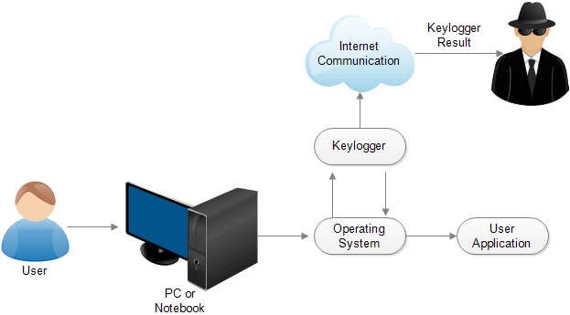
MODELLING
Teams cam add wireframes
3/21/2024 Annual Review
9

Slide 10
RESULTS
Our comprehensive security strategy delivers outstanding results, significantly reducing the risk of keylogger attacks. Through enhanced awareness and preparedness, users are equipped to recognize and avoid threats. Advanced detection tools and proactive measures ensure robust protection, while clear incident response plans guarantee swift, effective action. The outcome? Peace of mind, cost savings, reduced risk, and strengthened trust, safeguarding financial and reputational integrit
"Don't Let Keyloggers Infiltrate Your Security."
3/21/2024 Annual Review
10

